Slide 1
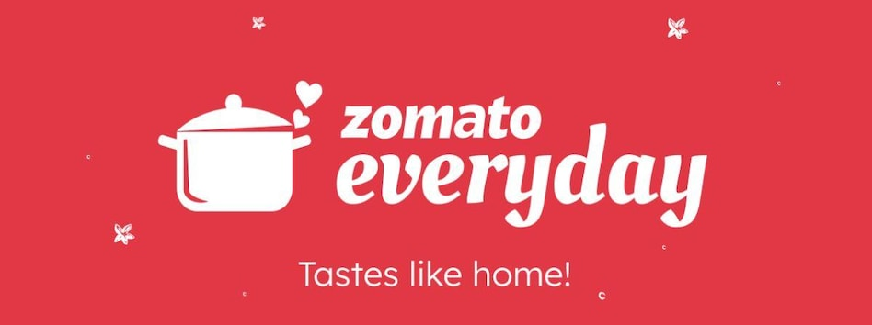
Zomato Restaurant Analysis
Team members:
K Ankita Singh Asmita Tamta
Karunesh Kumar Jaiswal IN Meghana
Pooja Vasdev Shobha Rani Vattikuti
Syed Murtaza Ali

Slide 2

INDEX
Introduction
Data Overview
Objectives and KPI
Analysis
Recommendations and Insights
Conclusion

Slide 3
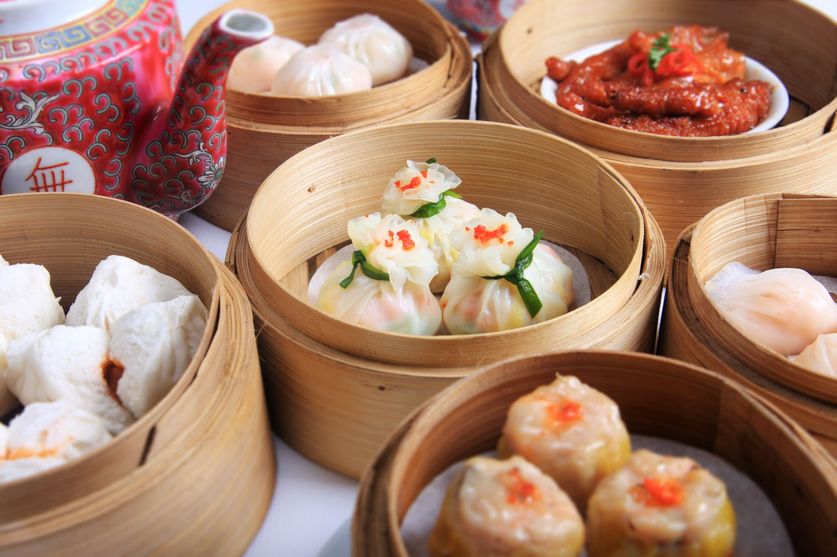
Introduction
Today, we embark on an exciting journey into the realm of global cuisine exploration through the lens of Zomato API data. Whether you're a passionate foodie seeking culinary adventures or someone keen on finding value-for-money dining experiences, this analysis promises to be insightful and rewarding.

Slide 4
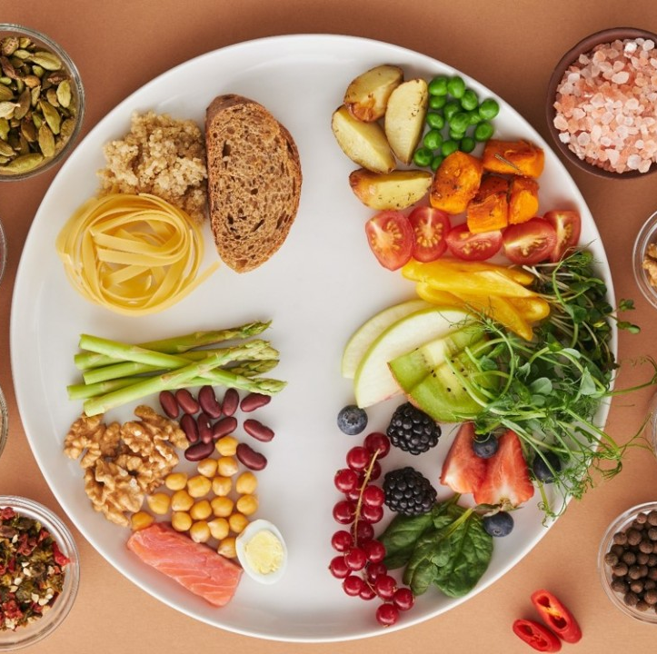
Data Overview
Popular Locations: Discover which areas within a city boast the highest concentration of top-rated dining establishments.
Restaurant Details: Restaurant ID, names, locations, and addresses.
Cuisine Offerings: An range of cuisines served by each restaurant, Exploring Diverse Cuisines across different cities Worldwide.
Pricing Information: Average cost for two, currency details, and price range.
User Interactions: Table booking, delivery options, aggregate ratings, and user votes.
Budget-Friendly Dining: Identify affordable dining options without compromising on quality.
Location Analysis: Data shows popular dining hubs and their characteristics.
Rating Insights: Understand how user ratings and reviews influence restaurant choices.

Slide 5

Objectives And KPI’s
The objective of this Zomato restaurant analysis is to uncover valuable insights into global dining trends, identify popular cuisines and dining locations, and assess factors influencing restaurant ratings and customer preferences.
Following are the KPI’s we’ll the discussing hereafter:
Find the Numbers of Restaurants based on City and Country.
Numbers of Restaurants opening based on Year , Quarter , Month
Count of Restaurants based on Average Ratings
Create buckets based on Average Price of reasonable size and find out how many restaurants falls in each buckets
Percentage of Restaurants based on "Has_Table_booking"
Percentage of Restaurants based on "Has_Online_delivery"
Develop Charts based on Cuisines, City, Ratings

Slide 6
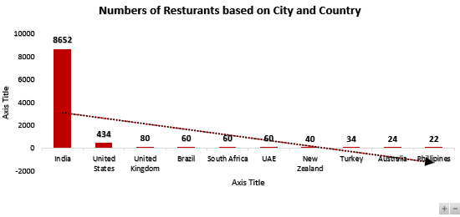
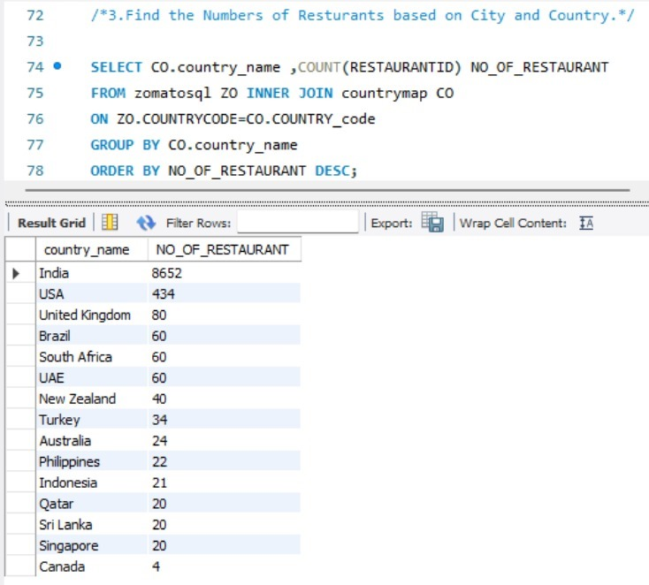
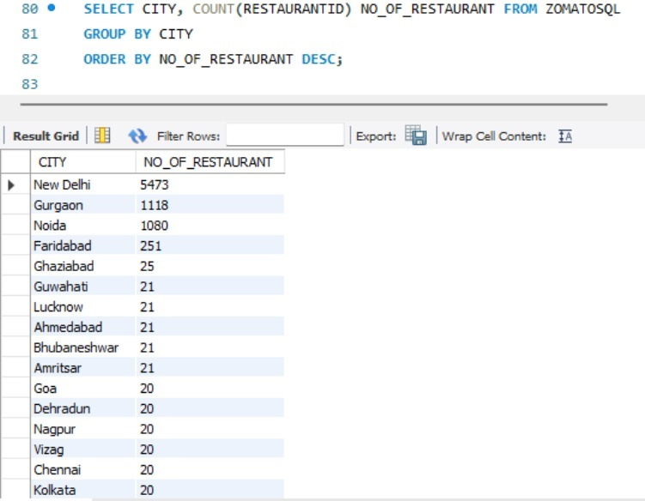
Analysis 1 : Number of Restaurants based on City and Country
OBSERVATION:
The Dataset had around 9551 Restaurants based on 141 cities located in 15 countries.
The maximum number of restaurants lie in Delhi city (5473) in India and least no of restaurants are in Canada.

Slide 7
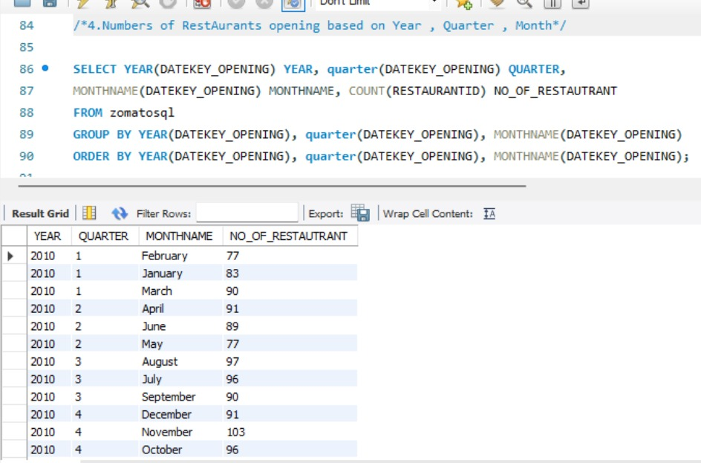
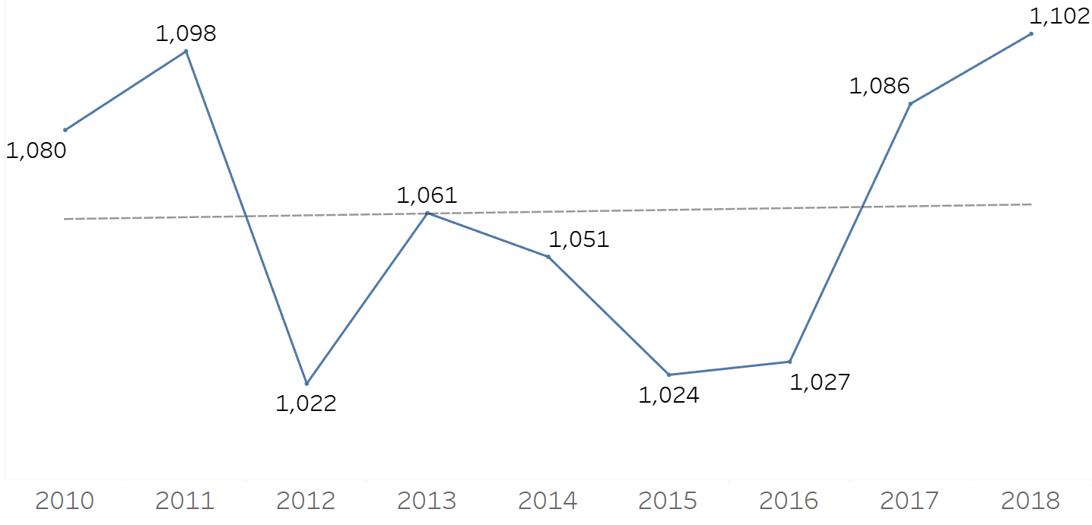
Analysis 2: Number of Restaurants opened based on Date
OBSERVATION:
The purpose of this query is to provide a detailed overview of the restaurant opening trends over time. By breaking down the data into years, quarters, and months, stakeholders can gain insights into:
Seasonal trends in restaurant openings.
Yearly growth patterns in the restaurant industry.
Specific months or quarters that see a higher or lower number of openings.

Slide 8
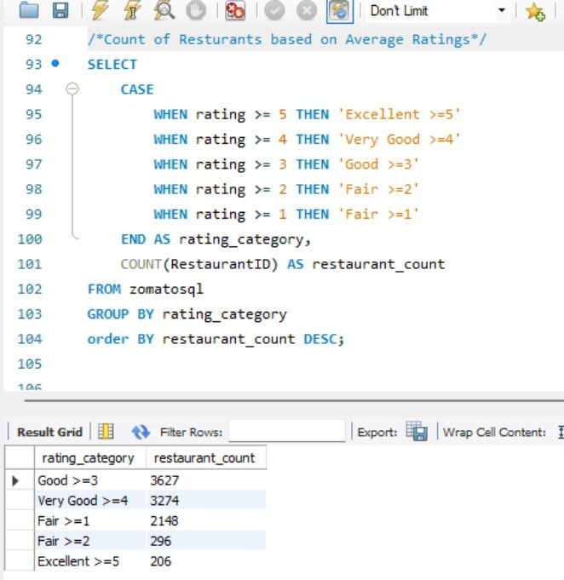
Analysis 3 . Count of Restaurants based on Average Ratings
OBSERVATION:
The purpose of this query is to provide an analysis of restaurant ratings within the dataset. The query breaks down the number of restaurants into specific rating categories. This helps stakeholders understand the distribution of restaurants quality as perceived by customers.

Slide 9
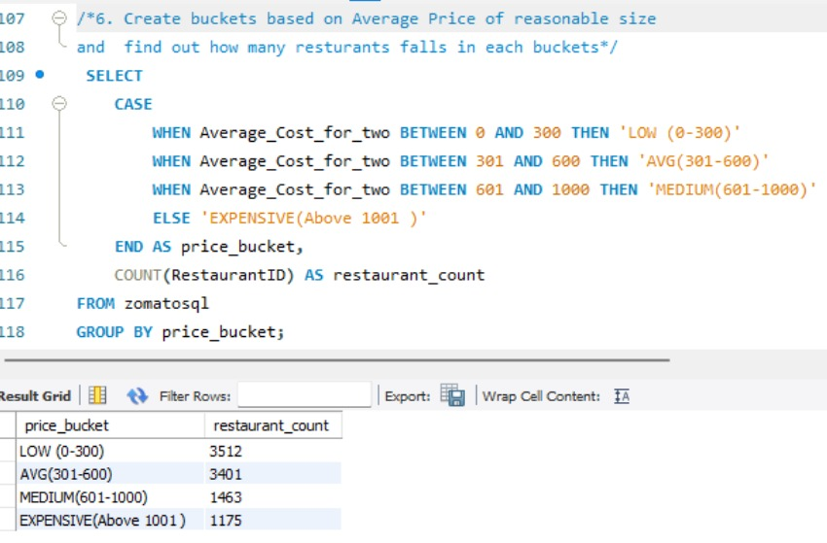
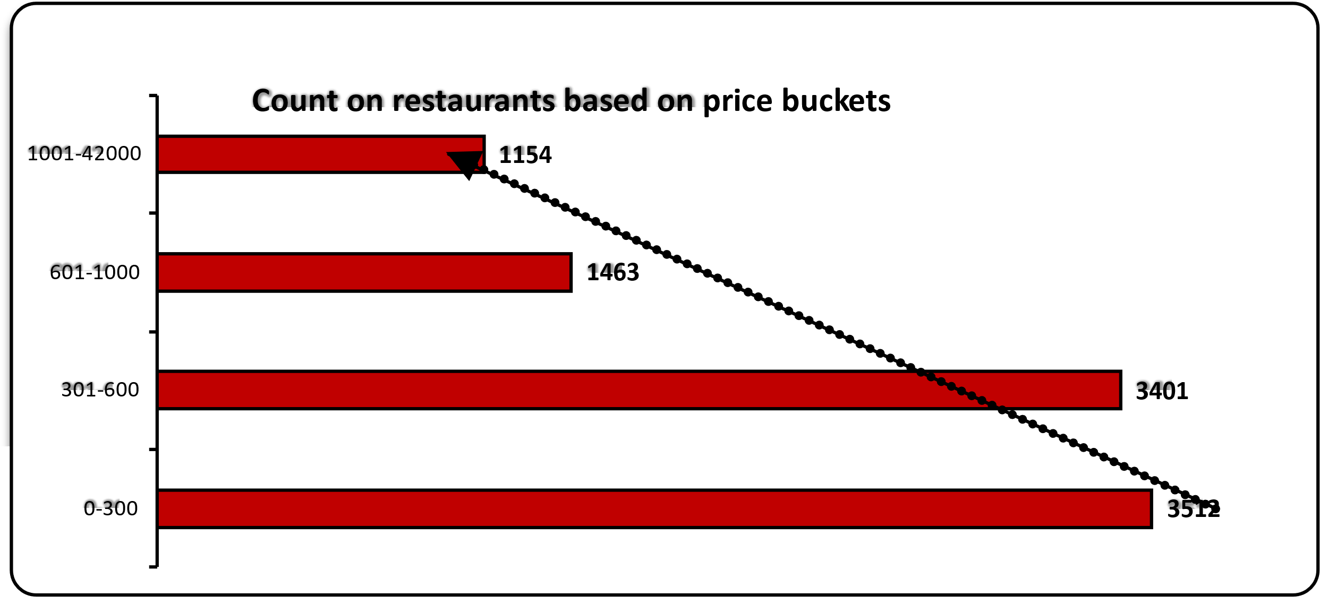
Analysis 4: No. of Restaurants based on price range
OBSERVATION:
This query effectively segments the restaurant data into meaningful price categories, providing a clear view of how restaurants are distributed based on their average cost for two people. This segmentation is crucial for understanding market pricing trends and making informed business decisions related to pricing and affordability.

Slide 10
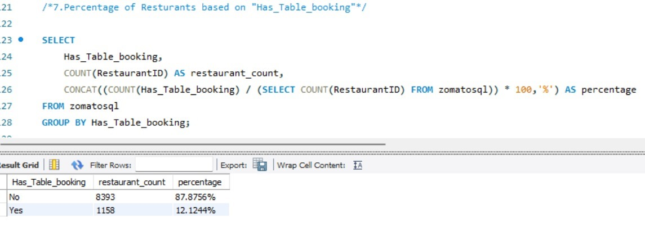
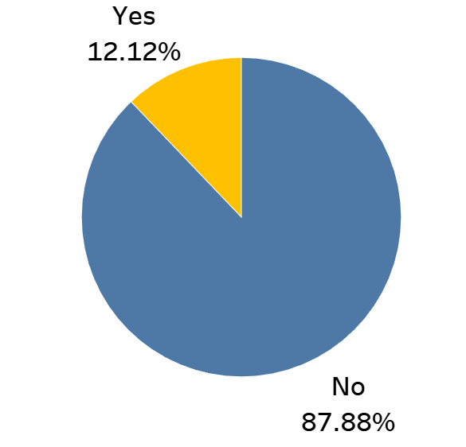
Analysis 5: Has Table Booking
OBSERVATION:
This query provides a clear view of the availability of table booking services among restaurants in the dataset. By presenting both the count and percentage, it offers a comprehensive understanding of how many restaurants offer this feature and what proportion they represent in the market. This information is crucial for understanding customer convenience and making strategic decisions regarding service offerings.

Slide 11
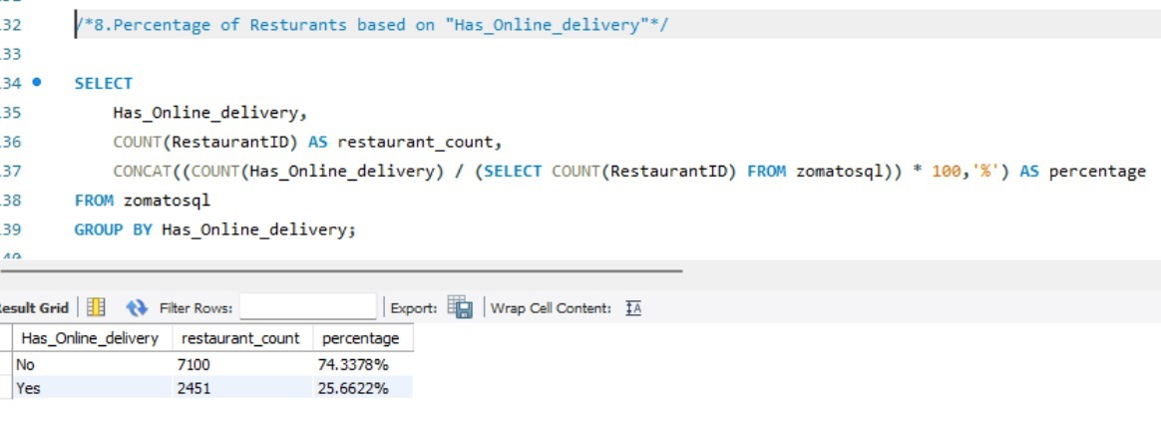
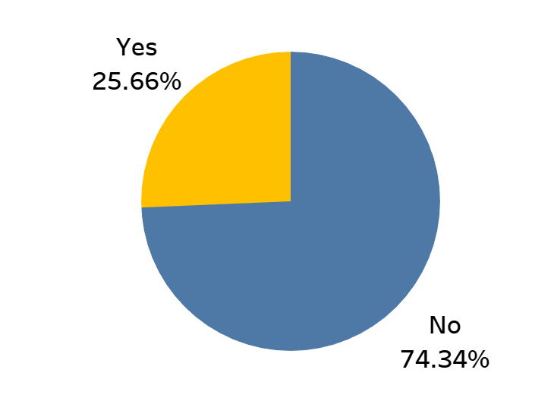
Analysis 6: Has Online Delivery
OBSERVATION:
This query provides a clear view of the availability of online delivery services among restaurants in the dataset. By presenting both the count and percentage, it offers a comprehensive understanding of how many restaurants offer this feature and what proportion they represent in the market. This information is crucial for understanding customer convenience and making strategic decisions regarding service offerings.

Slide 12
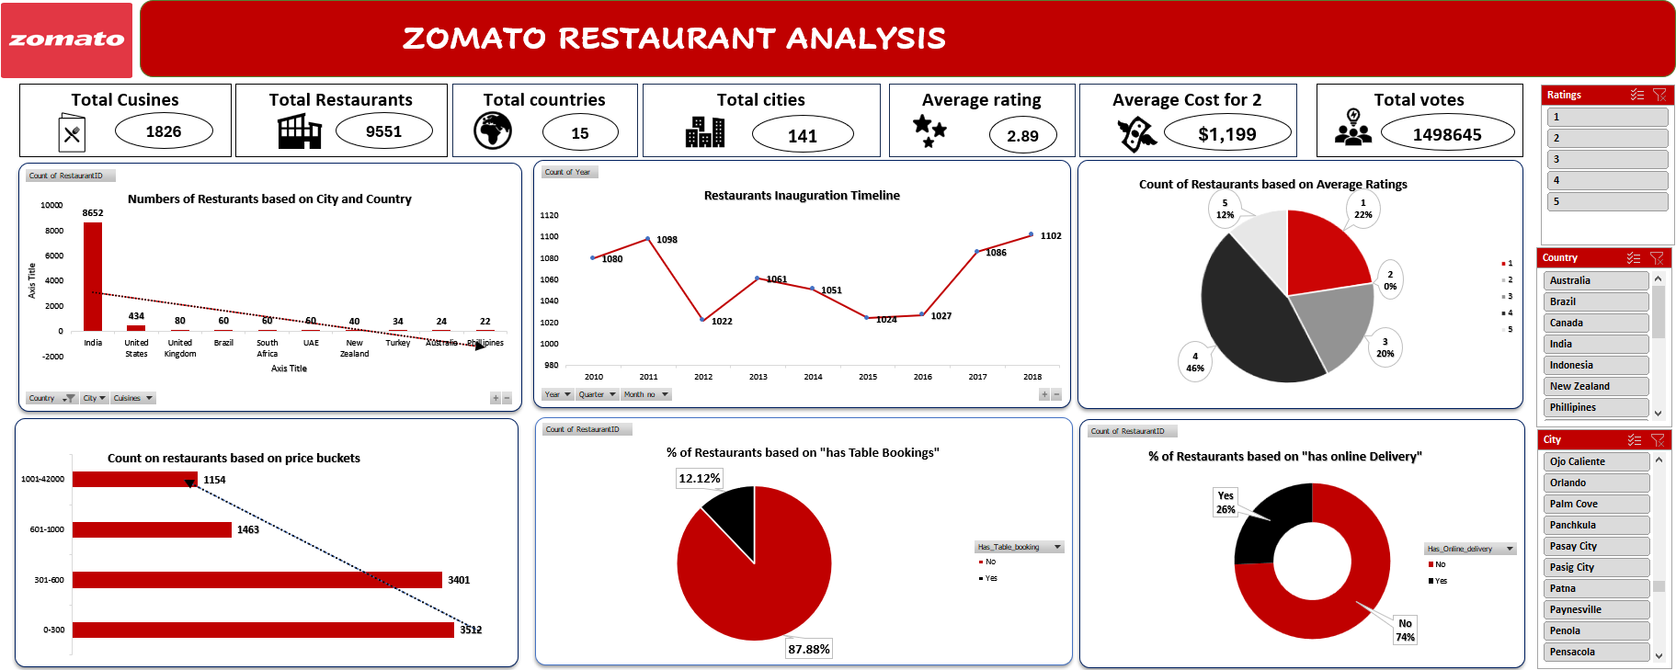
Excel Dashboard

Slide 13
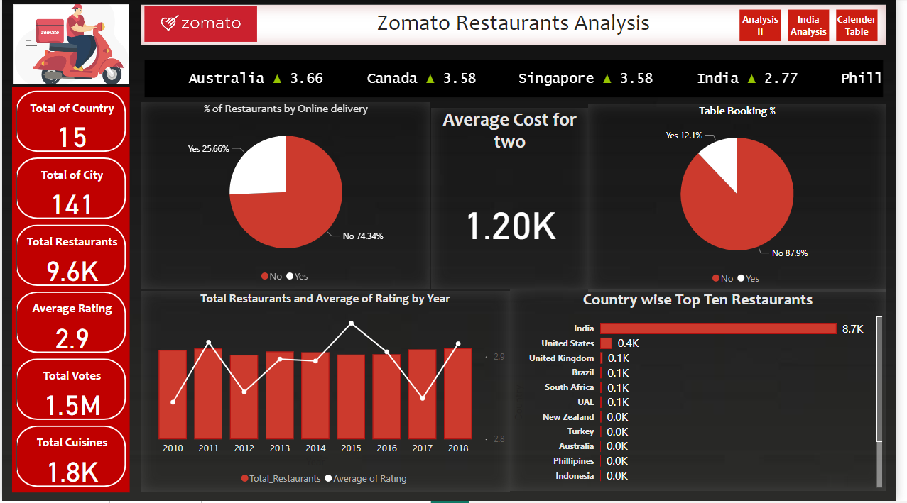
PowerBI Dashboard

Slide 14
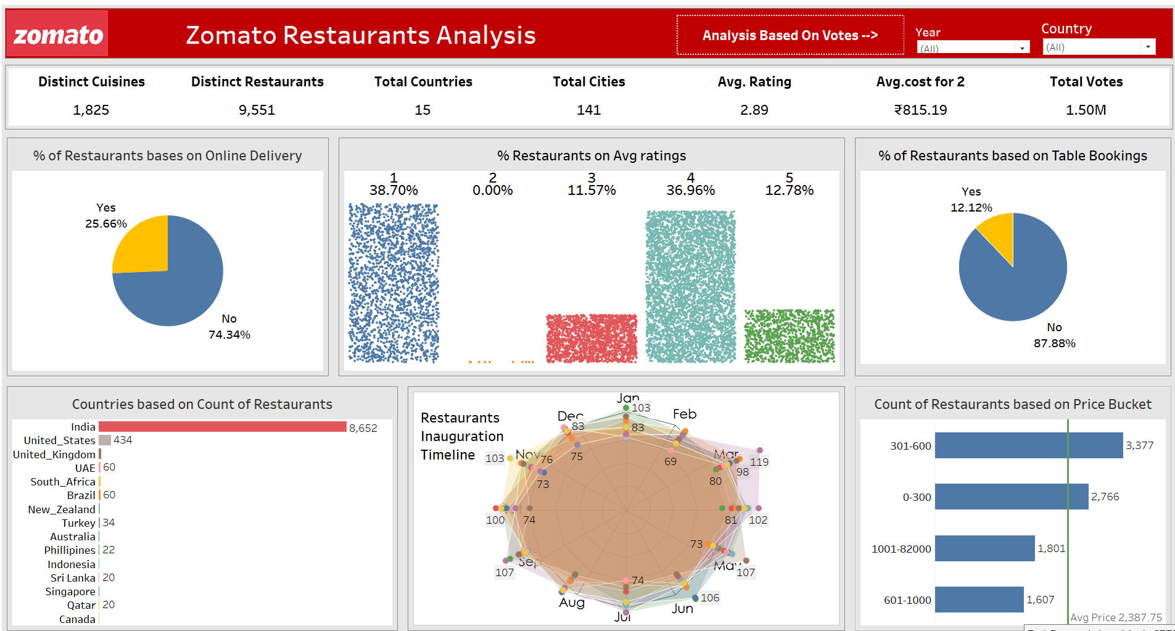
Tableau Dashboard

Slide 15
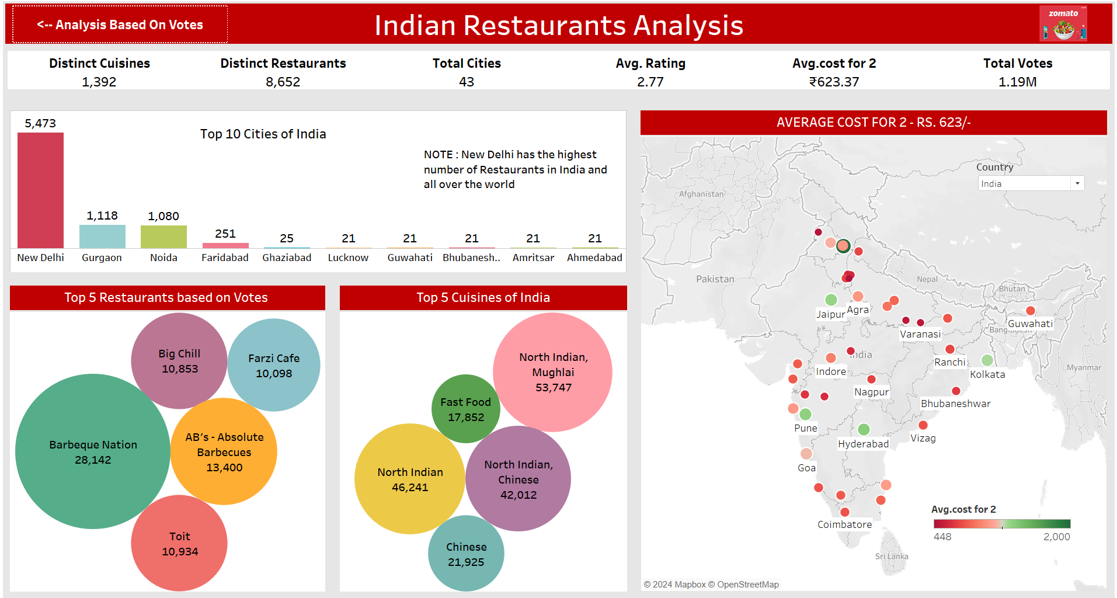
Tableau Dashboard

Slide 16
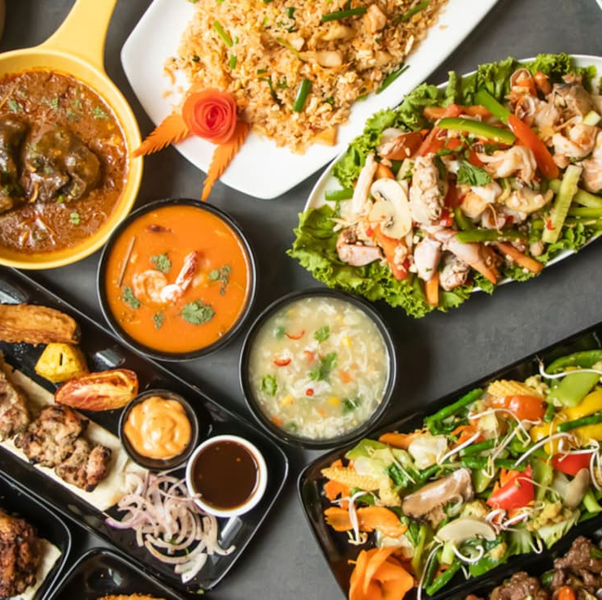
Recommendations and insights
There is a scope of improvement in increasing online table booking as presently it is only having 12.12%, Zomato should target people spending in range of 0-300 and 301 – 600 to get more customers with some offers that encourages people to book tables.
The data shows the restaurants who doesn't give online delivery is about 75% so Zomato should reach those restaurants and register them so both can get more orders.

Slide 17

Conclusion
It is observed that 38% of the restaurants give 1-star ratings, which is something Zomato should work on.
Zomato ratings are slightly above average i.e 2.9/5 globally and 2.8/5 in India.

Slide 18
Thank you

